Slide 1

Brain Tumor Prediction Using Deep Learning Network
Phase II - Review 2
Team Members:
Yukta N Shettigar [1DS19CS197]
Bhargavi S [1DS19CS198]
Keerthana K [1DS19CS721]
K R Diyvashree [1DS19CS722]
Under the guidance of
Prof. S Keerthi Aneesh Sanganeria
Assistant Professor, Co-Guide
Dept. of CSE, DSCE SDE- II, Jio
Department of Computer Science & Engineering, DSCE

Slide 2
CONTENTS
Abstract
Introduction
Literature Survey
Individual Contribution
Existing System
System Design- Proposed Architecture
Modules
Module Descriptions
Input
Algorithm
Output
Conclusion
Future Work
Co-Guide Meet Details
Project Tool Snapshot
References
Department of Computer Science & Engineering, DSCE

Slide 3
ABSTRACT
Brain tumor detection is critical for timely treatment.
ResNet50 model (CNN – Transfer Learning) is integrated with a web application.
Large collection of labeled MRI images are used for training and evaluation.
Preprocessing enhances image quality for optimal input to the network.
ResNet-50 is trained using to identify healthy tissues and tumor regions.
User-friendly interface is developed using Flask web framework.
Users can upload MRI scans, and the system performs tumor prediction and presents results.
Evaluation includes accuracy, precision, sensitivity, F1 score, AUC.
Achieved test accuracy of approximately 98%.
Results demonstrate the effectiveness of the approach in predicting brain tumor presence.
Classification of the brain MR Images into - Glioma, Meningioma, Pituitary, No tumor.
Department of Computer Science & Engineering, DSCE

Slide 4
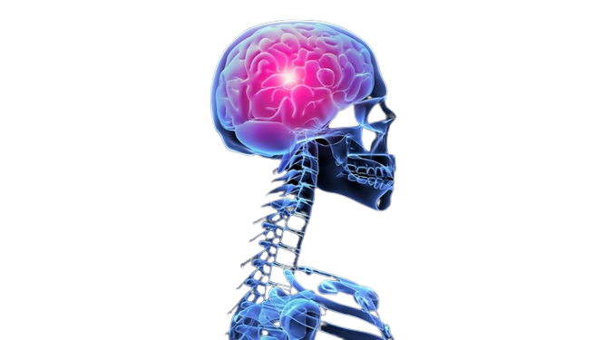
INTRODUCTION
Brain tumors can be primary or secondary (metastatic).
MRI is preferred for brain tumor diagnosis due to detailed imaging.
Manual segmentation is a time-consuming process and subjective.
Automatic segmentation reduces human errors.
CNNs are effective for accurate brain tumor detection.
ResNet50 is a deep learning model for feature extraction.
Addressing challenges of accuracy and efficiency in traditional classification methods.
Contributes to improved patient care and treatment outcomes.
Department of Computer Science & Engineering, DSCE

Slide 5
cv
LITERATURE SURVEY
SL No. | Authors | Title | Algorithms and Classifiers | Abstract | Result
1 | E.S.A. El-Dahshan, H.M. Mohsen, K. Revett, B.M. Salem A | Computer-aided diagnosis of human brain tumor through MRI: a survey and a new algorithm | Segmentation Region of Interest(ROI), ANN, PCNN | A hybrid technique for processing of MRI Images which first applies feedback pulse-coupled neural network as a front-end processor for image segmentation and detecting the region of interest, and then employs the discrete wavelet transform to extract features from MRI images. | Classification Accuracy of 99% with 100% Sensitivity rate and 92% Specificity rate
Department of Computer Science & Engineering, DSCE

Slide 6
cv
LITERATURE SURVEY
SL No. | Authors | Title | Algorithms and Classifiers | Abstract | Result
2 | W. Zhang, R. Li, H. Deng, L. Wang, W. Lin, S. Ji, D. Shen | Deep convolutional neural networks for multi-modality isointense infant brain image segmentation | Deep CNN for multi-modality brain image segmentation, Support Vector Machine (SVM) Classifier | Deep convolutional neural networks (CNNs) was used for segmenting iso-intense stage brain tissues (infant brain tissues) into white matter (WM), gray matter (GM), and cerebrospinal fluid (CSF). | CNN outperformed other methods for segmenting all three types of brain tissues
Department of Computer Science & Engineering, DSCE

Slide 7
cv
LITERATURE SURVEY
SL No. | Authors | Title | Algorithms and Classifiers | Abstract | Result
3 | Toan Duc Bui, Jitae Shin, Taesup Moon | Skip- connected 3D DenseNet for volumetric infant brain MRI segmentation, Biomed. Signal Process. | Fully Convolutional Densely Connected Network with Skip Connections for Volumetric infant brain tissue Segmentation, DenseNet for classification task | The suggested network, known as 3D-SkipDenseSeg, extends the benefit of the newly developed DenseNet for classification task to segment the brain tissue using MRI. | The best dice similarity coefficient (DSC) was attained by 3D-SkipDenseSeg, which was 90.37 1.38% (WM), 92.27 0.81% (GM), and 95.79 0.54%. (CSF)
Department of Computer Science & Engineering, DSCE

Slide 8
cv
LITERATURE SURVEY
SL No. | Authors | Title | Algorithms and Classifiers | Abstract | Result
4 | Salma Alqazzaz, Xianfang Sun, Xin Yang, Len Nokes | Automated brain tumor segmentation on multi-modal MR image using SegNet | Fully Convolutional Neural Network SegNet to 3D data | A fully convolutional neural network SegNet is applied to 3D data sets for four MRI modalities (Flair, T1, T1ce, and T2). This algorithm for precisely segmenting a brain tumor, attempts to locate the complete tumor volume and divide it into four sub-tumor regions. | F-measure scores were 0.85, 0.81, and 0.79. Specifically, for the augmenting tumor, the tumor core, and the overall tumor.
Department of Computer Science & Engineering, DSCE

Slide 9
INDIVIDUAL CONTRIBUTION
Yukta N Shettigar - 1DS19CS197 | AI/ML implementation
Bhargavi S - 1DS19CS198 | AI/ML implementation
Keerthana K - 1DS19CS721 | Web App Integration
K R Divyashree - 1DS19CS722 | Web App Integration
Department of Computer Science & Engineering, DSCE

Slide 10
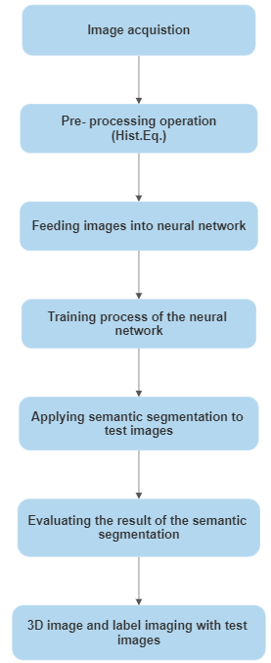
EXISTING SYSTEM
DRAWBACKS
ARCHITECTURE
Even though the model is highly effective to predict brain tumor in MR images accurately.
Performance of this system can be improved by adding more class identifications.
The number of training and test data could have been increased to obtain more results for improved tumor prognosis.
Department of Computer Science & Engineering, DSCE

Slide 11
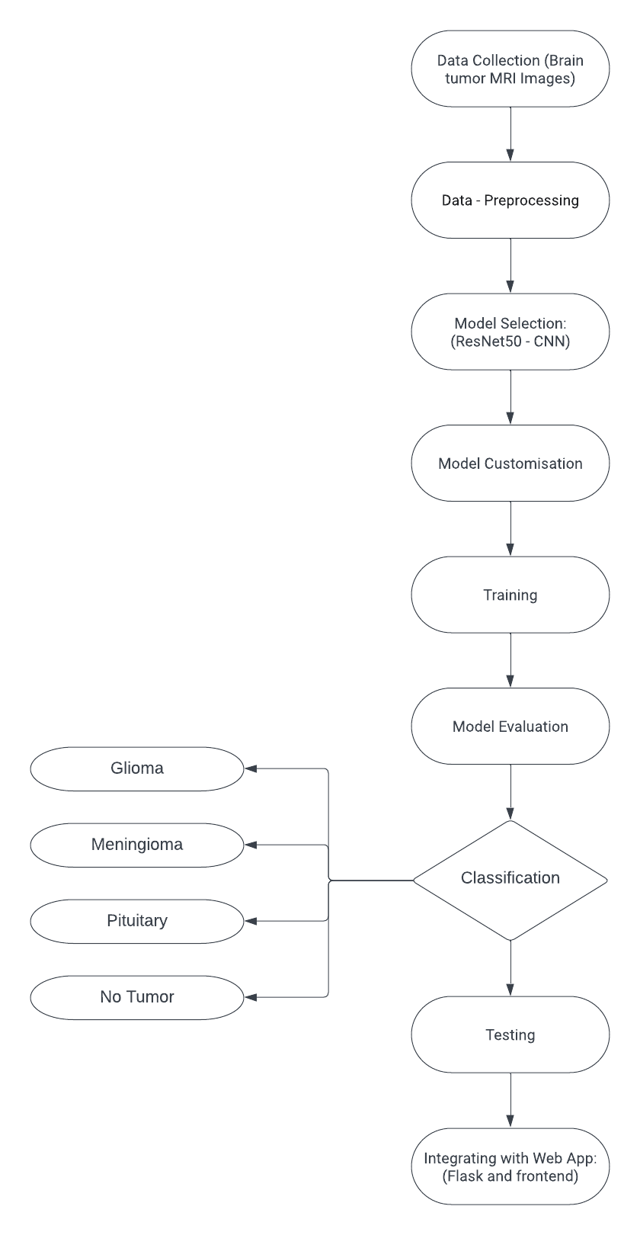
SYSTEM DESIGN- PROPOSED ARCHITECTURE
Department of Computer Science & Engineering, DSCE

Slide 12
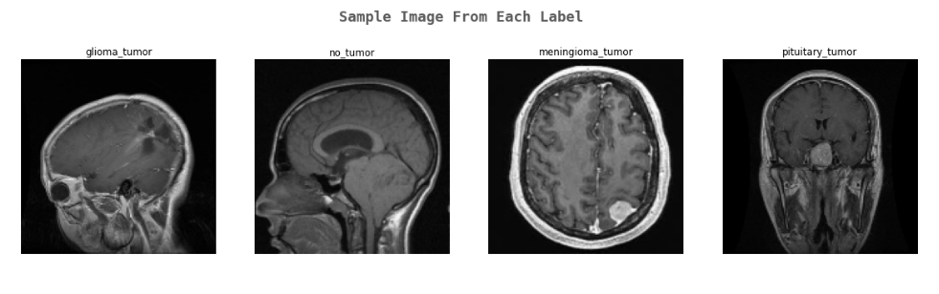
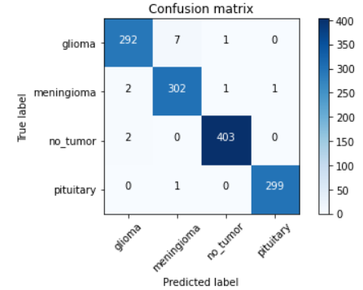
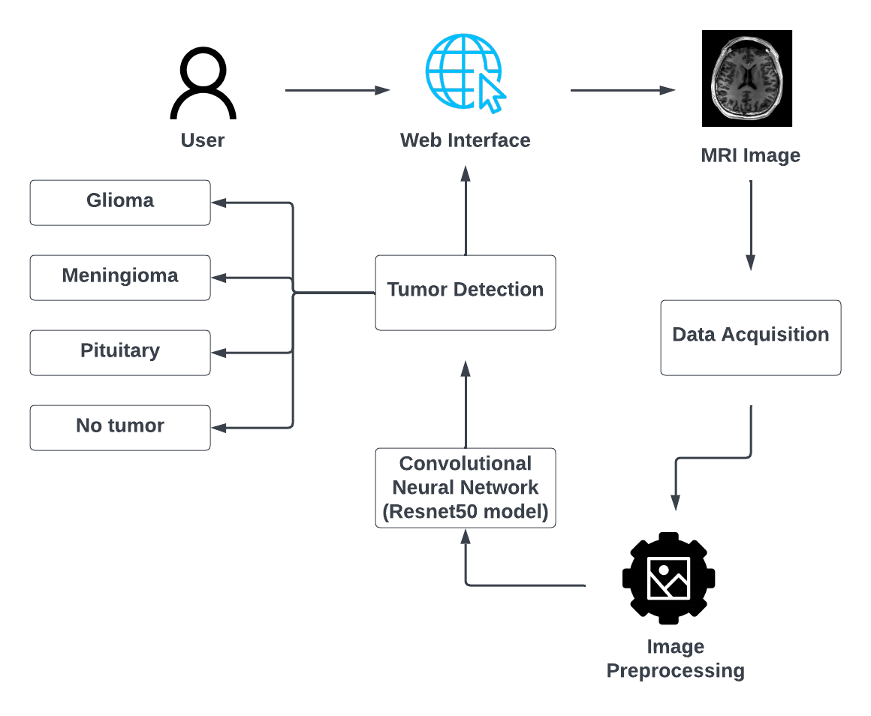
MODULES
Data Collection and Preparation
Data Pre-Processing
Model Selection
Model Customization
Training
Model Evaluation
Classification
Testing
Integrating with Web Application
Department of Computer Science & Engineering, DSCE

Slide 13
MODULE DESCRIPTIONS
(1) Data Collection and Preparation: The dataset is taken in reference from Kaggle (Brain Tumor MRI Dataset ) along with real time data.
(2) Data Preprocessing:
Involves resizing the images to a consistent resolution, normalizing pixel intensities, and augmenting the images and improving the model performance.
The dataset is then divided into training, validation, and testing subsets.
(3) Model Selection:
Model: ResNet50 model.
ResNet50 is a DCNN architecture that has been pre-trained on a large dataset (e.g., ImageNet) containing millions of images.
Department of Computer Science & Engineering, DSCE

Slide 14
MODULE DESCRIPTIONS
(4) Model Customization:
The original classification layer is removed from the ResNet50.
It is replaced with a new fully connected layer that matches the number of tumor classes in the dataset.
(5) Training:
The model learns to extract features from the images and make predictions based on the tumor type labels.
Loss function: categorical cross-entropy.
Optimization algorithm: Adaptive Moment Estimation (Adam).
These two are used to update the model's parameters.
Department of Computer Science & Engineering, DSCE

Slide 15
MODULE DESCRIPTIONS
(6) Model Evaluation:
The Performance Metrics used to evaluate the model include: accuracy, precision, sensitivity, F1 score and AUC.
(7) Classification:
The tumor is classified into any of the 4 categories namely, Glioma, Meningioma, Pituitary and No Tumor.
(8) Testing:
Once the model is trained and evaluated, the independent testing set was used to evaluate its performance on unseen data.
Department of Computer Science & Engineering, DSCE

Slide 16
MODULE DESCRIPTIONS
(9) Integrating with Web Application:
This Brain Tumor Prediction and Classification Model is then incorporated into a web-based application to make it user-friendly.
Stages associated with the integration
Department of Computer Science & Engineering, DSCE

Slide 17
INPUT
Dataset: Kaggle
Department of Computer Science & Engineering, DSCE

Slide 18
ALGORITHM
Firstly, we import necessary libraries which includes: numpy, pandas, seaborn, cv2, tensorflow, sklearn, imutils, etc.
Then, Pre-Processing stage is carried out which includes data cleaning, resizing the images, etc.
The labels are assigned for all the four categories of tumor.
A series of Erosion and Dilations (after setting threshold) are performed in order to remove small regions of noise. The largest contours found in the threshold image was picked. The extreme points found on the image were cropped out.
The dataset was split into Training (80%) and Testing (20%).
Then, we perform One-Hot Encoding on the labels after converting it into numerical values.
Department of Computer Science & Engineering, DSCE

Slide 19
ALGORITHM
DCNN models may take days or even weeks to train on very large datasets, hence we will be using the ResNet50 Model which is a Transfer Learning Technique where the model is pre – trained.
For Classification task : Optimization Algorithm – Adam
Loss Function – Categorical Cross – Entropy
The brain tumors are classified into any of the 4 main categories:
(a) Glioma (b) Meningioma (c) Pituitary (d) No Tumor
The trained model is saved to an .h5 file, which is further used in integrating with the Web Application.
Users can upload their MRI scans through the web interface, and the integrated system will process the images, perform tumor prediction, and present the results to the user.
Department of Computer Science & Engineering, DSCE

Slide 20
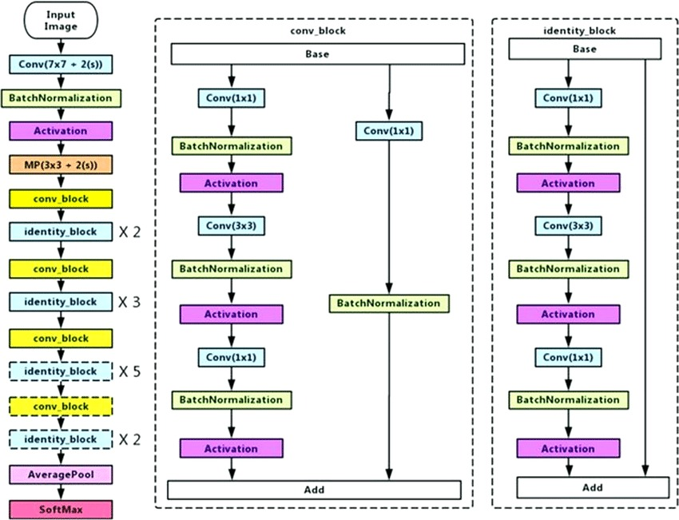
ALGORITHM-ResNet50 Model
Department of Computer Science & Engineering, DSCE

Slide 21
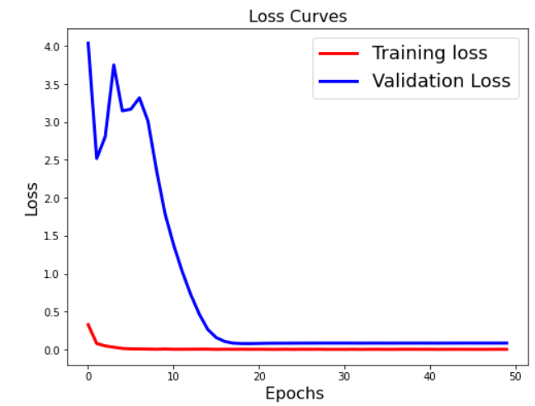
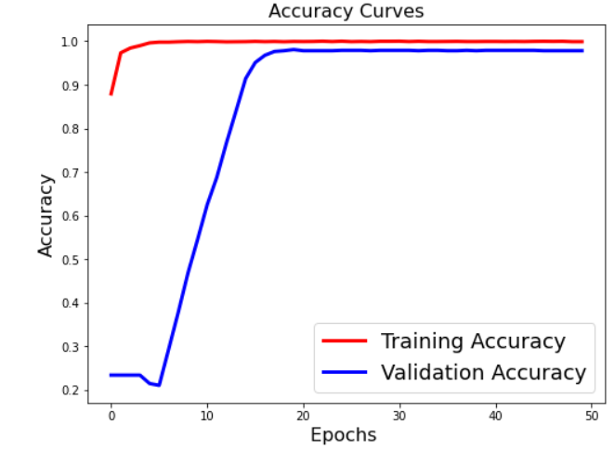
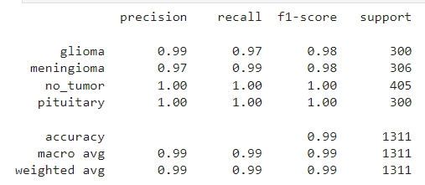
OUTPUT
Evaluation Metrics
Department of Computer Science & Engineering, DSCE

Slide 22
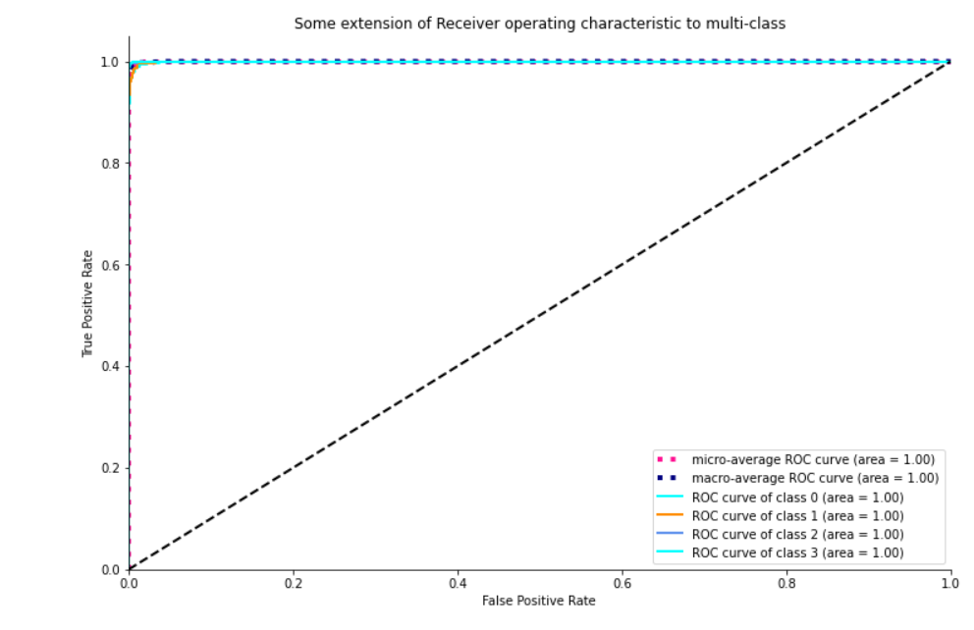
OUTPUT
Confusion Matrix
ROC Curve
Department of Computer Science & Engineering, DSCE

Slide 23
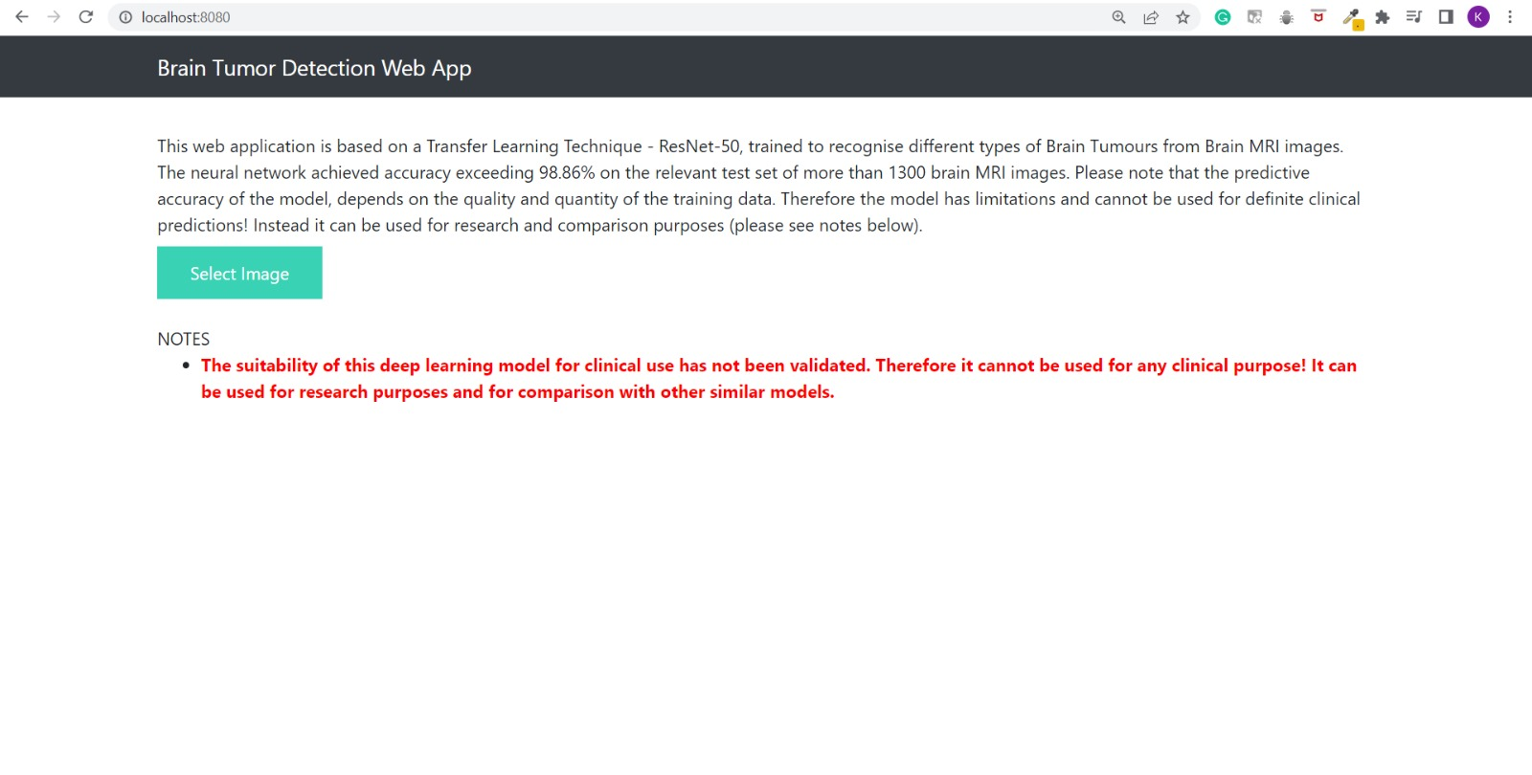
OUTPUT
Web Page of Brain Tumor Prediction Web Application
Department of Computer Science & Engineering, DSCE

Slide 24
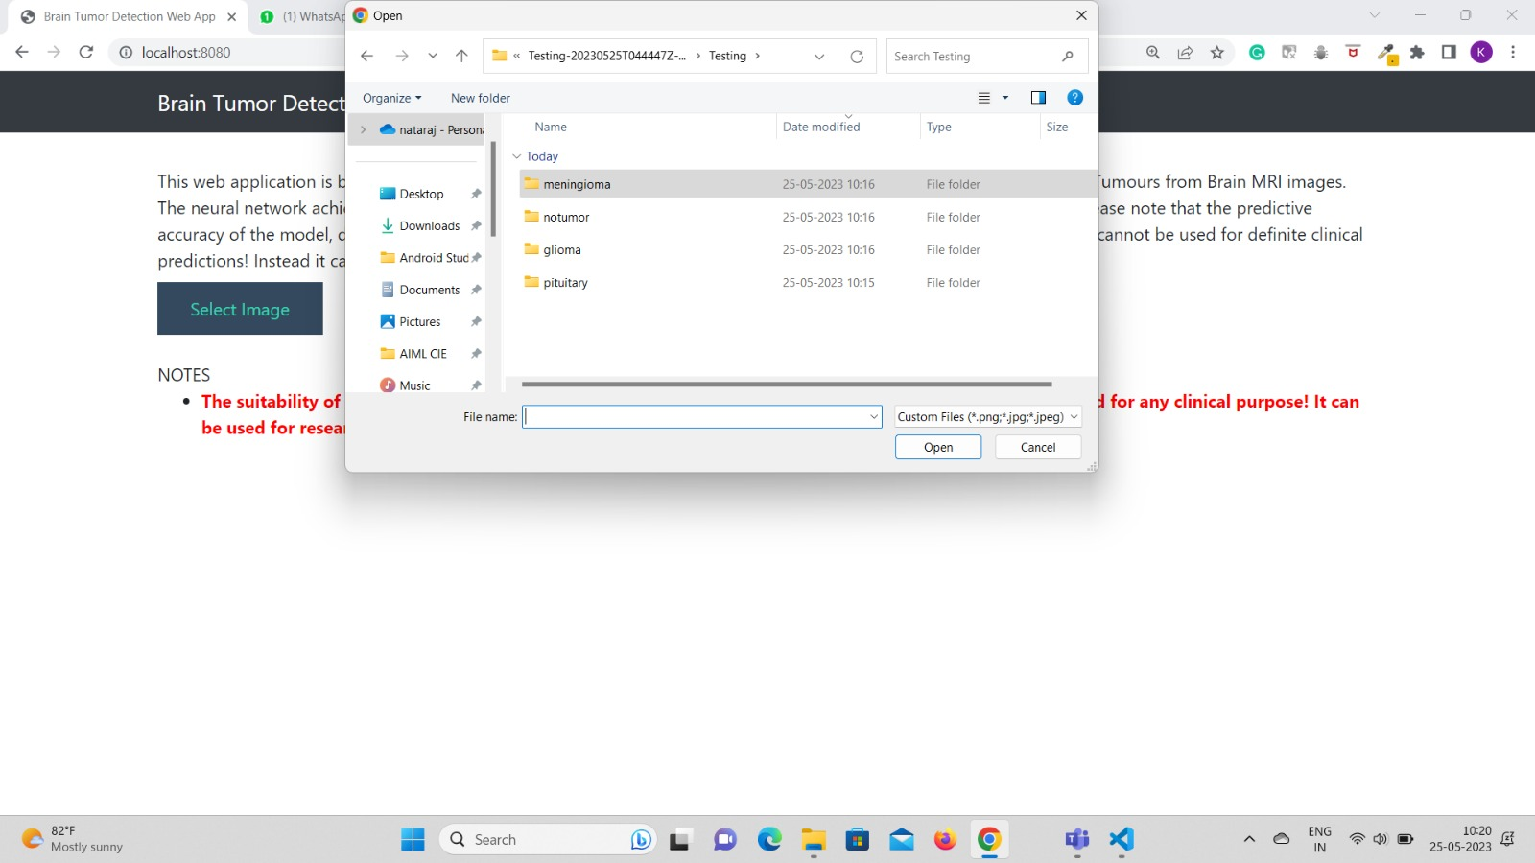
OUTPUT
Selection of an MR image
Department of Computer Science & Engineering, DSCE

Slide 25
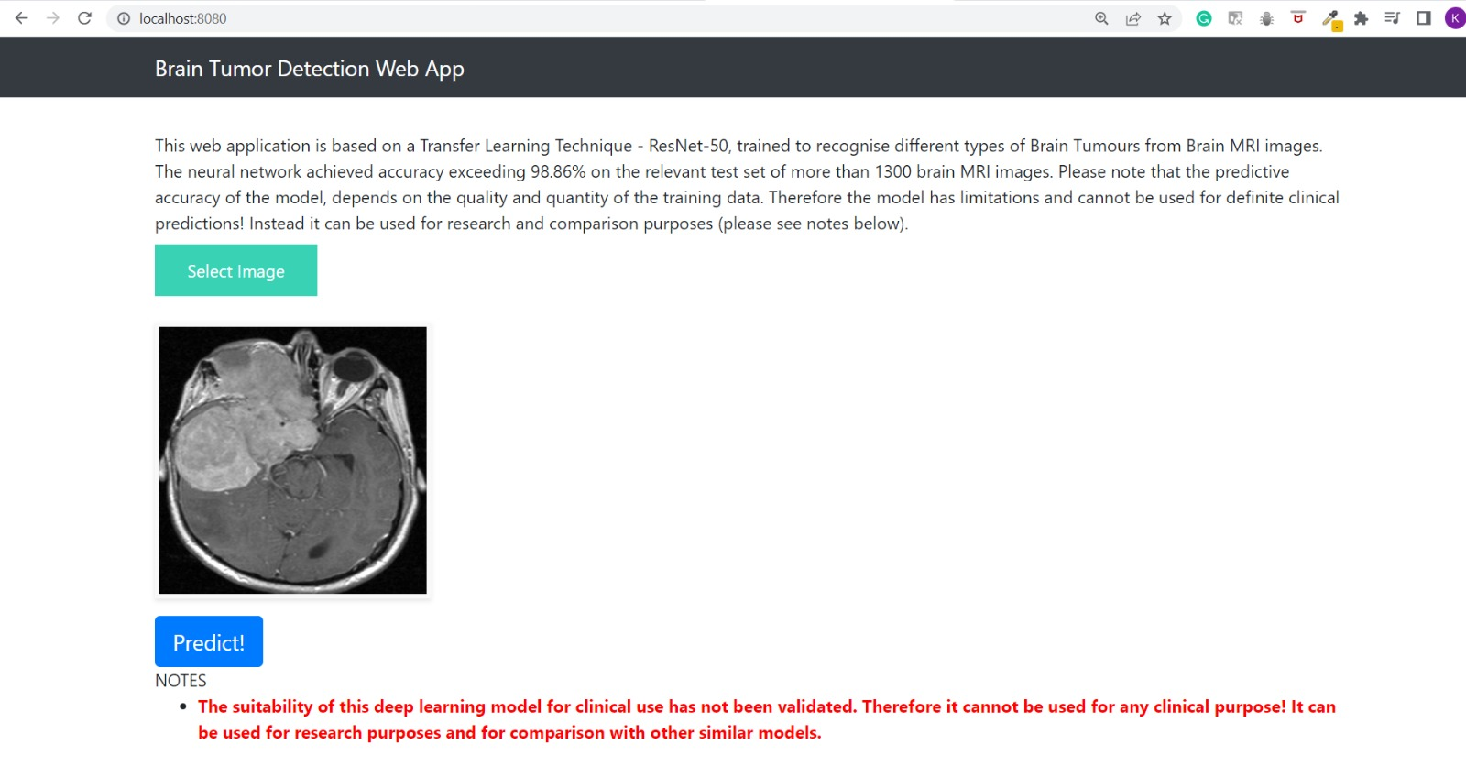
OUTPUT
Uploading an Image of Brain Tumor (Meningioma Tumor) for Prediction
Department of Computer Science & Engineering, DSCE

Slide 26
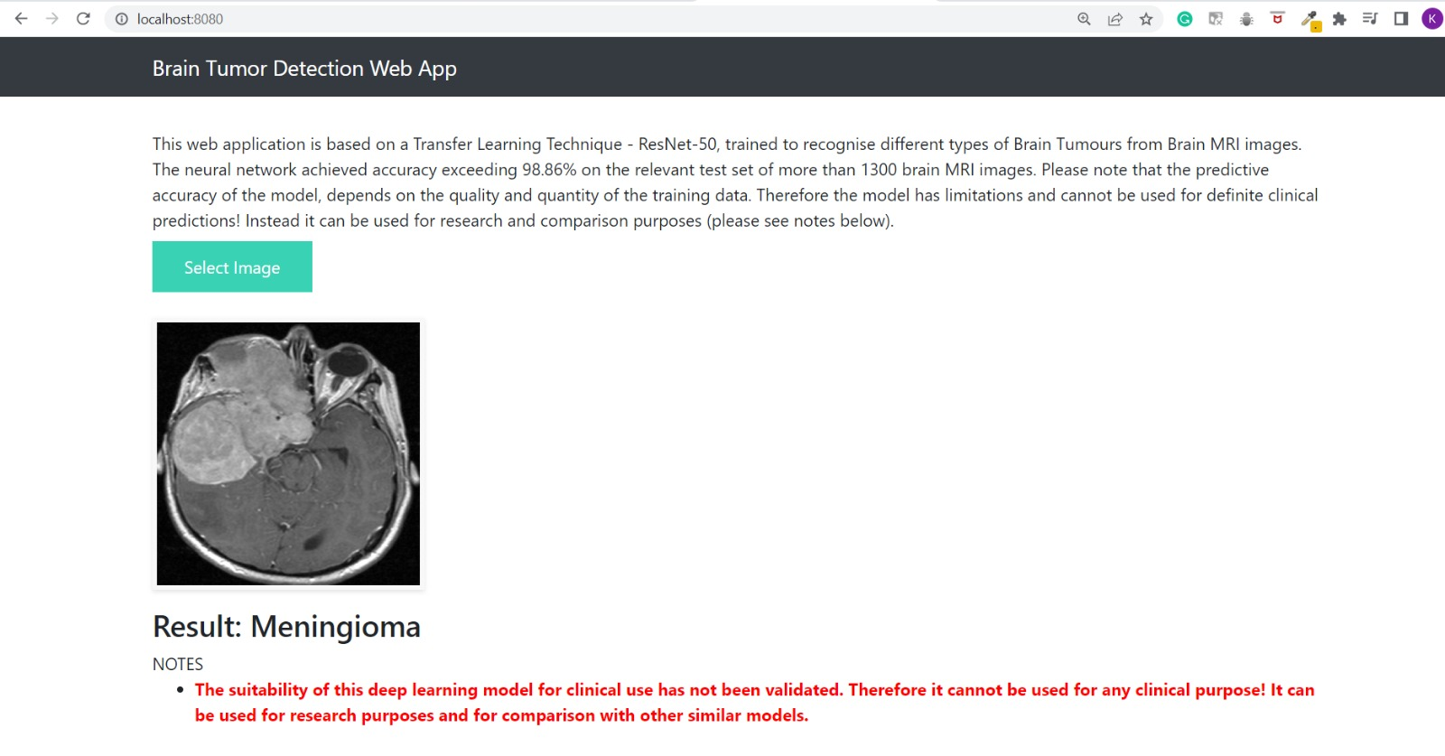
OUTPUT
Prediction Results for the MRI image uploaded (Meningioma Tumor)
Department of Computer Science & Engineering, DSCE

Slide 27
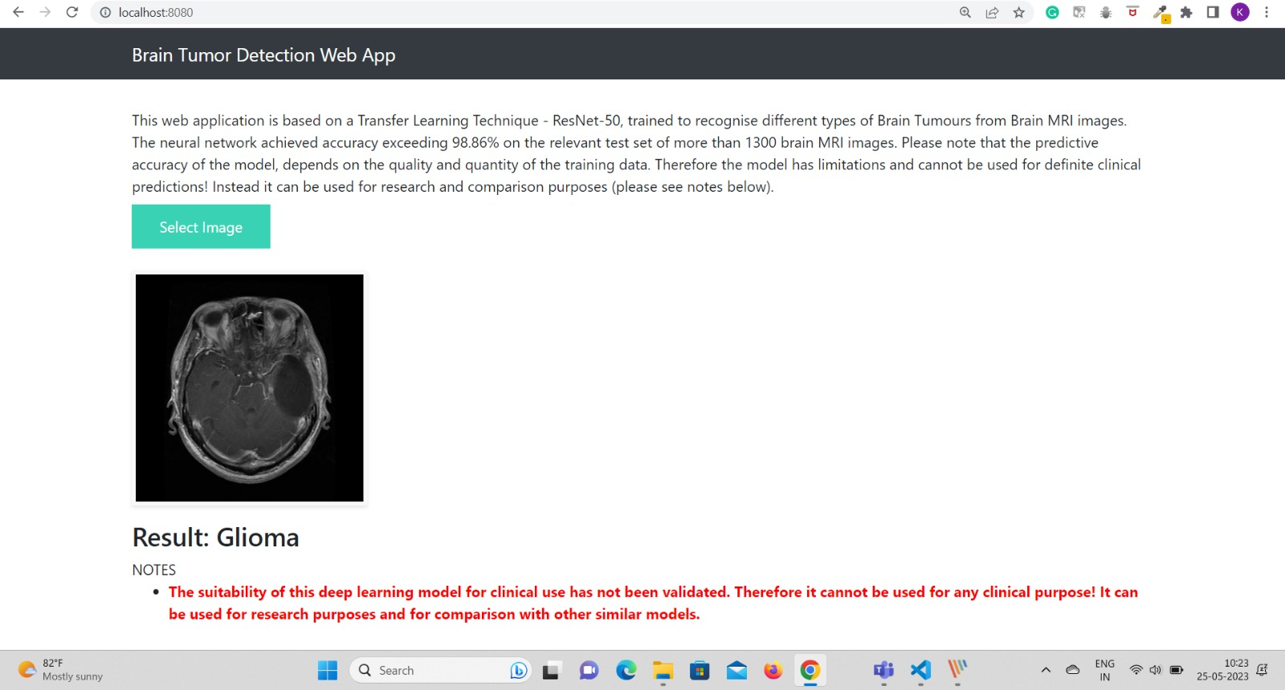
OUTPUT
Prediction Results for the MRI image uploaded (Glioma Tumor)
Department of Computer Science & Engineering, DSCE

Slide 28
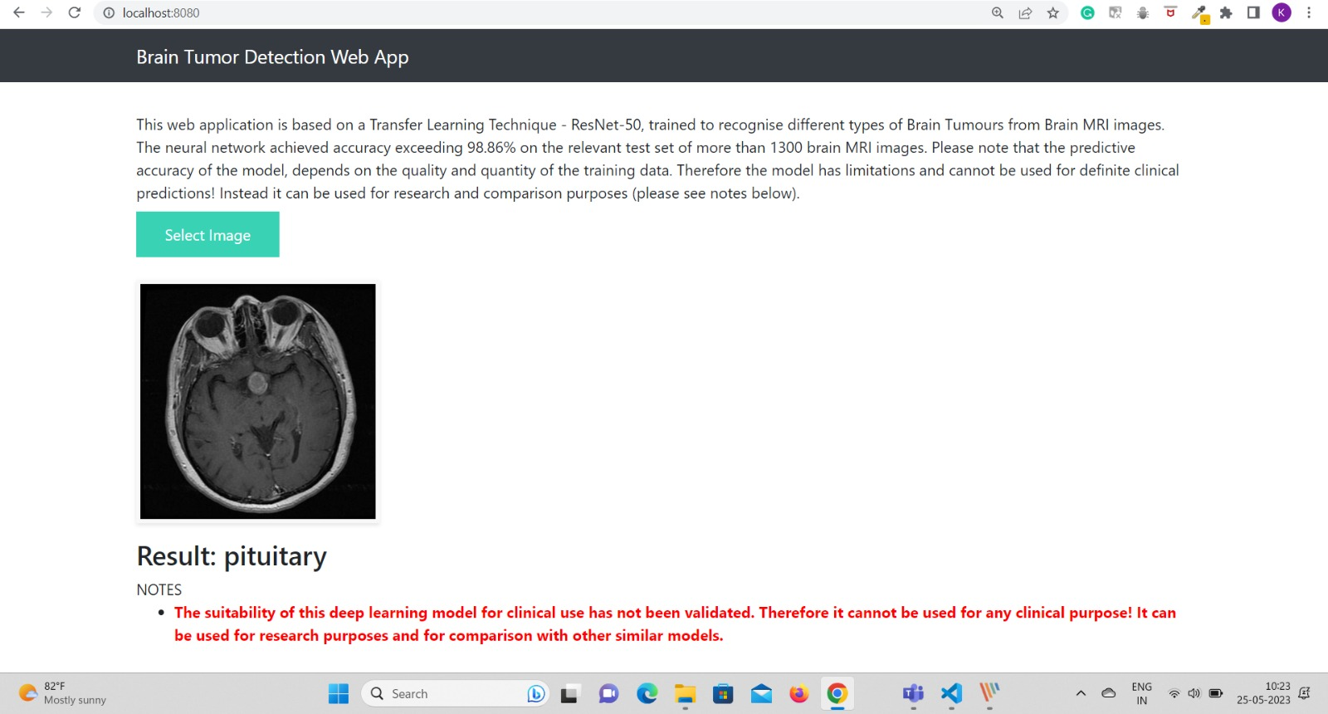
OUTPUT
Prediction Results for the MRI image uploaded (Pituitary Tumor)
Department of Computer Science & Engineering, DSCE

Slide 29
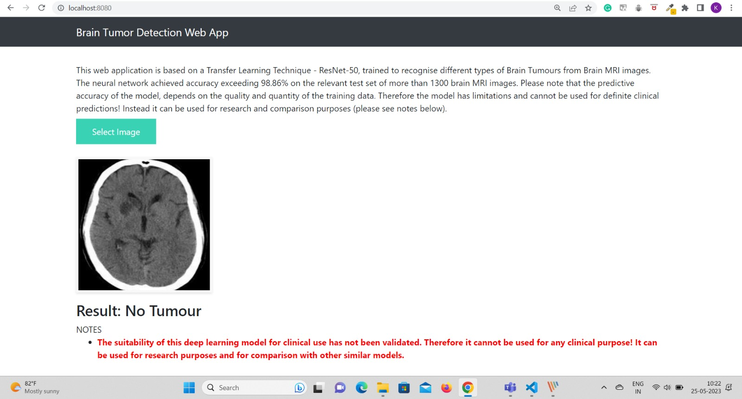
OUTPUT
Prediction Results for the MRI image uploaded (No Tumor)
Department of Computer Science & Engineering, DSCE

Slide 30
CONCLUSION
ResNet-50 has proven to be a highly accurate and robust model for brain tumor classification.
Its deep layers enable it to capture intricate features, leading to precise identification of different tumor types.
The model demonstrates scalability, allowing for further improvements as more labeled data becomes available.
ResNet-50 provides interpretable results, achieving around 98.86% accuracy.
Deploying ResNet-50 in clinical practice holds significant potential for enhancing automated diagnosis and treatment planning for brain tumors.
Department of Computer Science & Engineering, DSCE

Slide 31
FUTURE WORK
Ensemble Models:
Combining ResNet-50 with other deep learning models or traditional machine learning algorithms can create powerful ensemble models, improving classification accuracy and robustness.
Explainable AI:
Developing methods to explain the model's predictions and decisions can increase trust and acceptance in clinical settings, facilitating its adoption by medical professionals.
Real-Time Diagnosis:
Optimizing ResNet-50 for real-time processing can enable its integration into imaging systems, facilitating immediate diagnosis and enhancing the efficiency of brain tumor detection.
Department of Computer Science & Engineering, DSCE

Slide 32
CO-GUIDE MEET DETAILS
Meet no. & Date | Points Discussed | Suggestions | Suggestions taken into account
Meet 1- 11th JAN 2023 | Team Members Introduction. Presented Problem Statement & Objectives. | To start with the implementation. To prepare Literature Survey. | Started to carry out literature survey.
Meet 2- 25th JAN 2023 | Literature Survey of related papers. Implementation details were briefed. | Journals to publish the paper. Start with the implementation. | Published Survey paper. Proceeded with the implementation.
Meet 3- 10th APR 2023 | Implementation done till date. Further implementation details. | Gave us an insight on web-app integration. Flask suggested for Backend. | Flask used as backend framework. Integrated with web-app.
Meet 4- 3rd JUNE 2023 | Demonstration of final project | Future work -To display the reason for detecting a particular type of tumor. | Future Work suggested will be taken into consideration.
Department of Computer Science & Engineering, DSCE

Slide 33
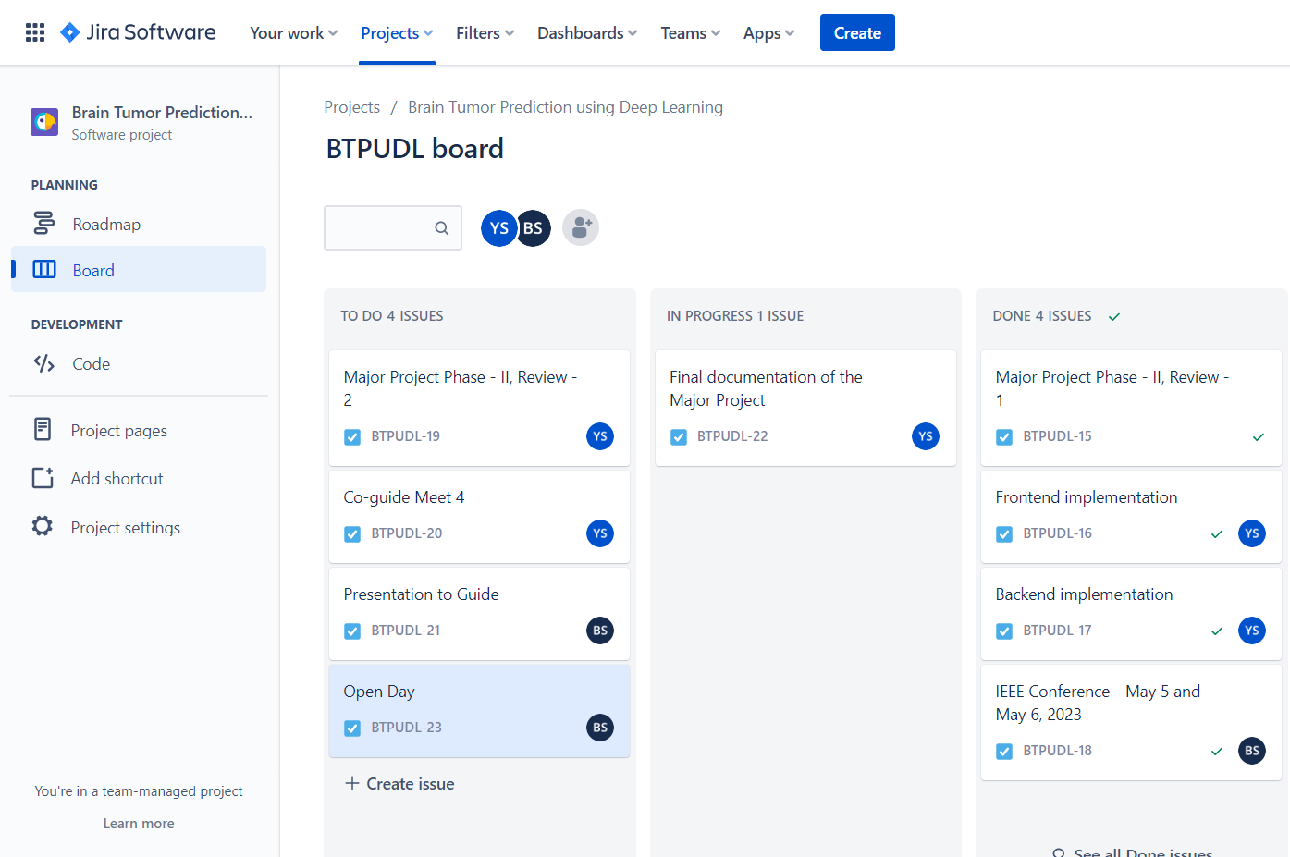
PROJECT TOOL SNAPSHOT
Department of Computer Science & Engineering, DSCE

Slide 34
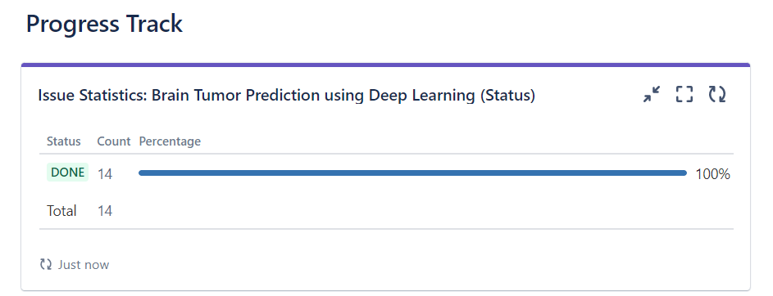
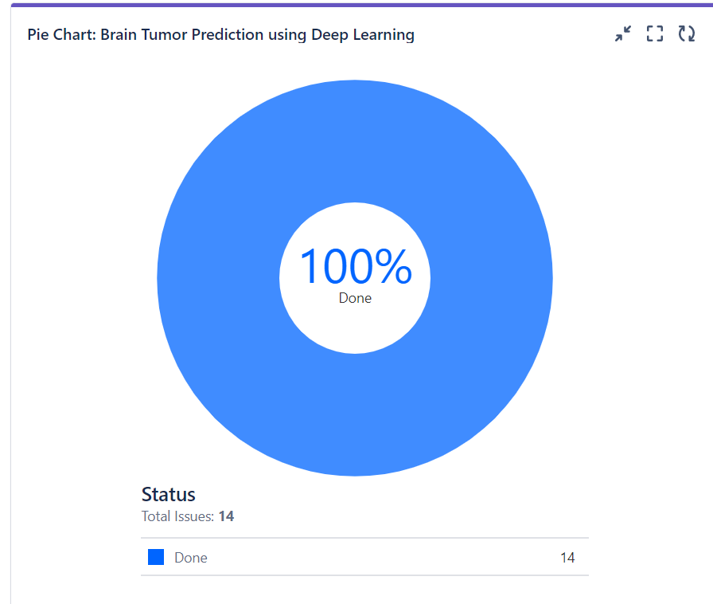
PROJECT TOOL SNAPSHOT
Department of Computer Science & Engineering, DSCE

Slide 35
REFERENCES
[1] E.S.A. El-Dahshan, H.M. Mohsen, K. Revett, B.M. Salem A-, Computer-aided diagnosis of human brain tumor through MRI: a survey and a new algorithm, Expert Syst. Appl. 41 (11) (2014) 5526–5545.
[2] W. Zhang, R. Li, H. Deng, L. Wang, W. Lin, S. Ji, D. Shen, Deep convolutional neural networks for multi-modality isointense infant brain image segmenta- tion, NeuroImage 108 (2015) 214–224.
[3] Toan Duc Bui, Jitae Shin, Taesup Moon, Skip- connected 3D DenseNet for volumetric infant brain MRIsegmentation, Biomed. Signal Process. Control 54 (2019) 101613.
[4] Salma Alqazzaz, Xianfang Sun, Xin Yang, Len Nokes, Automated brain tumor segmentation on multi-modal MR image using SegNet, Comput. Vis. Media 5 (June 2) (2019) 209–219.
[5] N. Bahadure, A. Kumar Ray, H. Pal Thethi, Image analysis for MRI based brain tumor detection and feature extraction using biologically inspired BWT and SVM, Int. J. Biomed. Imaging (2017) 1–12.
[6] Sayan Kahali, Sudip Kumar Adhikari, Jamuna Kanta Sing, A two-stage fuzzy multiobjective framework for segmentation of 3DMRI brain image data, Appl. Soft Comput. 60 (2017) 312–327.
Department of Computer Science & Engineering, DSCE

Slide 36
REFERENCES
[7] K.B. Vaishnavee, K. Amshakala, An automated MRI brain image segmentation and tumor detection using SOM-clustering and proximal support vector machine classifier, IEEE Int.Conf. Engineering and Technology (ICETECH) (2015).
[8] L. Wang, F. Shi, G. Li, Y. Gao, W. Lin, J.H. Gilmore, D. Shen, Segmentation ofneonatal brain MR images using patch-driven level sets, NeuroImage 84 (2014) 141–158.
[9] Mehdi Amian, Mohammadreza Soltaninejad, Multi-Resolution 3D CNN for MRI Brain Tumor Segmentation and Survival Prediction, Lecture Notes in Computer Science (LNCS), 2021.
[10] O. Çiçek, A. Abdulkadir, S.S. Lienkamp, T. Brox, O. Ronneberger, 3D U-Net: learning dense volumetric segmentation from sparse annotation, in: International Conference on Medical Image Computing and Computer- Assisted Intervention (MICCAI), Springer, 2016, pp. 424–432
Department of Computer Science & Engineering, DSCE

Slide 37
THANK YOU!
Department of Computer Science & Engineering, DSCE

